Slide 1
Validation
Abhijit Ramesh Patil

Slide 2
What is cross validation ?
Cross validation is a technique in which we train our model using subset of the data set and then evaluate using complementary subset of data set.
The purpose of cross validation is to test the ability of machine learning model to predict new data
Steps in cross validation
Reserve some portion of sample data set
Using the rest data-set train the model
Test the model using the reserve portion of data-set

Slide 3
What are different methods of cross validation ?
Methods of cross validation
1) Validation
2) LOOCV (Leave One Out Cross Validation)
3) K-fold cross validation

Slide 4
Explain each and every method
1. Validation : Splitting of data is 50% training and 50% testing.
Drawback is training is performed on 50% of dataset, so there is possibility of missing important information in remaining 50% data while training our data.
2. Leave One Out Cross Validation: In this method we perform training on whole data set but leaves only one data point and then iterates for each data point.
Drawback is it leads to higher variation in testing model as we are testing against one data point

Slide 5
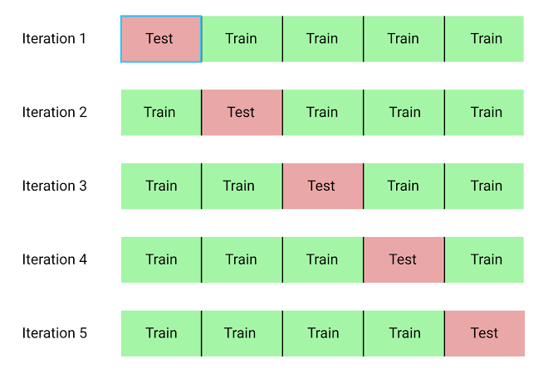
K fold cross validation: In this method we split data into K number of subset (known as folds).
Then we perform training on all the subset for evaluation of trained model.
In this method, we iterate K times with different subset reserved for testing purpose each time.
Advantages:
It is K time faster
It is more accurate
More efficient use of data

Slide 6
Why do we prefer using K fold cross validation over other methods ?
K fold cross validation runs K times faster LOOCV.
It is more accurate.
More efficient use of data as every observation is used for both training and testing.

